Slide 1
Locomotor Disability Dexterity Interface (LDDI)
Shri Shankaracharya Institute of Professional Management & Technology, Raipur
Major Project(Phase-I) Report on
CSE 7th Semester
Department of Computer Science and Engineering,
Batch 2019-2023
Session July – Dec 2022
Presentation Date: 24/01/2023
Project Guide
Mr. Abhishek Kumar Saw
(Asst.Professor, CSE Dept)
Project Group Members:
Member 1- Kashika Parmar
303302219051
Member 2-Aayush Mishra
303302219001
Member 3-Saurabh Kansara
303302219090

Slide 2
Introduction about Project
The project is titled as “Operating System for Locomotor Disability”.
Many people feel confused about what is Locomotor Disability. We often come across this term but it doesn’t ring a bell.
Locomotor Disability means restriction in the movement of the limbs (i.e. arms and legs).
Strictly speaking Locomotor Disability means problem in moving from one place to another — i.e. disability in legs. locomotor disability hampers movement from one place to another.
Locomotor disability is also known as mobility disability.

Slide 3
Application Area
Why did you opt to work on this project?
Locomotive Disability Dexterity Interface is a boon to the society which basically helps the person with locomotor disability to interact with the technologies present and keep up pace with the current world. This is an initiative of making a GUI interface that will interact with the human and their working senses will interact with the interface to produce a required outcome.
What are the Applications and Benefits of this project?
The solution is the removal of all cultural, physical, social and other barriers that prevent persons with disabilities from equally accessing opportunities and participating fully in all aspect. The system eliminates the usage of devices, and it improves the human-computer interaction.
Who are the End Users of this project?
A Locomotor Disabled person.

Slide 4
Literature Review
Literature Survey
Fabian Timm and Erhardt Barth in their paper Accurate Eye Centre Localization by Means of Gradients stated that many computer vision method fails in detecting eyes because of low resolution, low contrast or occlusions. So, they used the idea of image gradients which works simple objective function only consisting of dot products . Gesture Recognition Based Mouse Events by author Rachit Puri states that recognizing gestures is a complex task which involves task like motion modeling, motion analysis, pattern recognition and machine learning. V. Upasana, M. Joseph and Kanchana Venkata subbaiah author states in their paper Virtual Mouse with RGB colored tapes that the application developed by them using Human- Computer Interaction approach seeks to perform or control mouse cursor tasks using a camera and computer vision technologies like gesture recognition. Eye movement is the subject of research in this field because eye-gaze is an input that has the potential to create an effective computer interface, a small 2D mark is employed as a reference to compensate for this movement.

Slide 5
Literature Review
Problem Identification
Eyes are the most important of our senses it helps gather information and knowledge about the external world. So vision are important part of the whole body, the way we gaze through our eyes, the way we move our eyes or track a object throw our vision is associated with how we pay attention of our environment.
The idea is to help the community those who are facing locomotive disability so that they keep a pace with the new technologies and are in line with the emerging tech world.

Slide 6
Methodology
LDDI is an integration of computer vision and GUI programming OpenCV is FOS machine learning and computer vision software library. Computer vision is a field which is derived from Deep Learning (DL) and Artificial Intelligence (AI). It allows the computer to interpret important information from data such as films, videos, images, etc. Just like AI gives a machine the ability to think, Computer Vision gives the machine the ability to see, interpret, and visualise the given data.
Computer vision gives head drive to the field of AI by using image and videos to extract useful and informative data. There are a lot of similarities between how a computer processes an image and how a human eye processes an image. The context of computer is saved but you can’t really depend on humans brain.

Slide 7
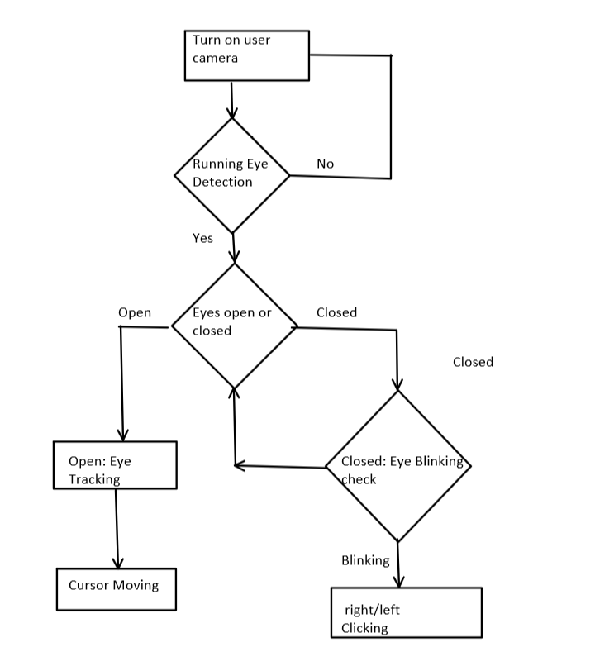
Work Flow Diagram

Slide 8
Project Work Flow Diagram
DFD for level 0 and level 1
Mouse for tracking and clicks
Webcam capturing images
User

Slide 9
Web camera taking images
User Eye/Mouth Movements
Image is stored
Process Image and find pixels
Taking image for processing
Mapping pixel position to mouse input
Produce mouse movements & clicks

Slide 10
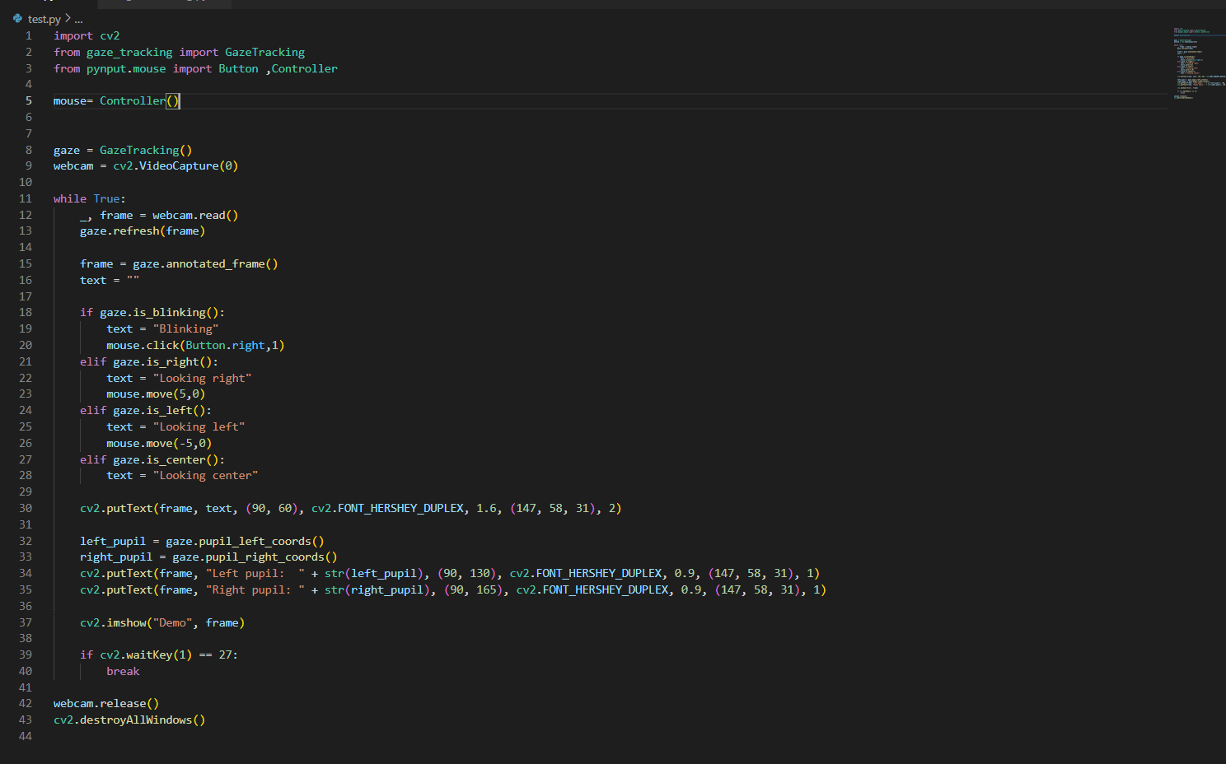
Snapshots

Slide 11
Code Description
First, we import all libraries. Here we used OpenCV, PYNPUT and Gaze Tracking.
Then we calibrate the position of the eye.
If the eye is closed(left or right), subsequent click actions are performed.
Else, movement of the cursor id determined by the position of the eye(left,right,up,down,center).

Slide 12
Result and Conclusion
After running this code, the user’s eye will work as an input for the mouse, allowing them to browse their computer easily without need of any other physical movement.
This project will help people with locomotor disability and paralysis to interact with modern computers easily.

Slide 13
References
Web Resources
https://www.oecd.org/coronavirus/policy-responses/using-artificial-intelligence-to-help-combat-covid-19-ae4c5c21/
https://www.hindawi.com/journals/jhe/2021/8133076/
https://www.researchgate.net/figure/Flowchart-of-The-Methods-of-Gesture-Based-Mouse_fig1_336304431

Slide 14
Paper Publication Details
Paper Publication Certificate

